Slide 1
UNIT 1
Introduction to DBMS

Slide 2
Introduction to Database Management System
As the name suggests, the database management system consists of two parts. They are:
Database
Management System
What is a Database?
To find out what database is, we have to start from data, which is the basic building block of any DBMS.

Slide 3

Data: Facts, figures, statistics etc. having no particular meaning (e.g. 1, ABC, 19 etc).
Record: Collection of related data items.
E.g. in the above example the three data items had no meaning.
But if we organize them in the following way, then they collectively represent meaningful information.

Slide 4
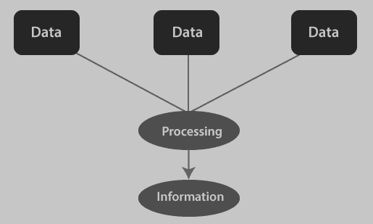

Slide 5
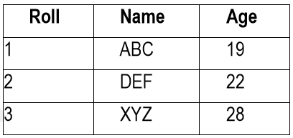
Table or Relation: Collection of related records.
The columns of this relation are called Fields, Attributes or Domains.
The rows are called Tuples or Records.

Slide 6
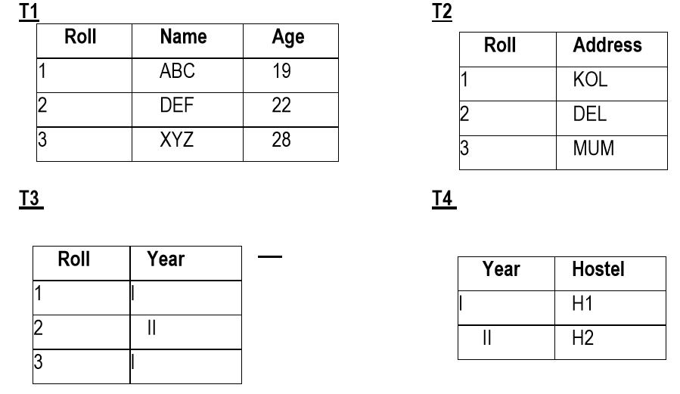
Database: Collection of related relations.
“Which hostel does the youngest student live in?”

Slide 7
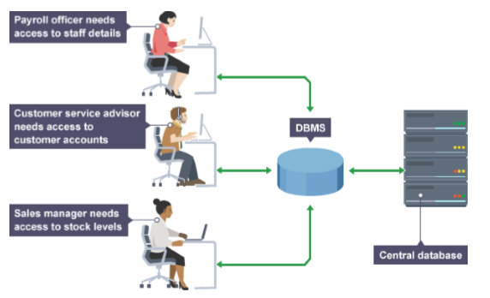
A database in a DBMS could be viewed by lots of different people with different responsibilities.
Employees are accessing Data through DBMS

Slide 8
What is Management System?
A database-management system (DBMS) is a collection of interrelated data and a set of programs to access those data.
The primary goal of a DBMS is to provide a way to store and retrieve database information that is both convenient and efficient.

Slide 9
Database Management System (DBMS)
A Database management system is a computerized record-keeping system.
It is a repository or a container for collection of computerized data files.
The overall purpose of DBMS is to allow the users to define, store, retrieve and update the information contained in the database on demand.
Information can be anything that is of significance to an individual or organization.

Slide 10
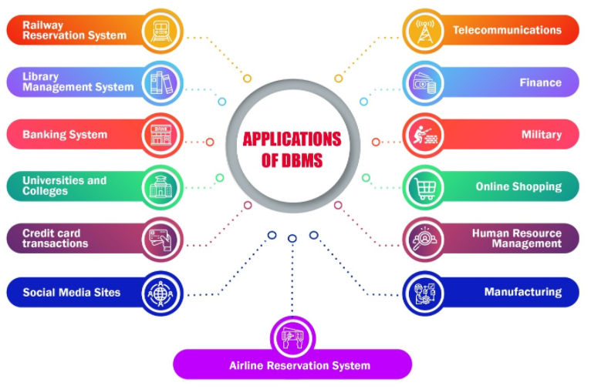
Database System Applications

Slide 11
Banking: For customer information, accounts, loans, and banking transactions.
Universities: For student information, course registrations, attendance and results.
Airlines: For reservations and schedule information.
Telecommunication: For keeping records of calls made, generating monthly bills, maintaining balances on prepaid calling cards, and storing information about the communication networks.
Manufacturing: Manufacturing companies make products and sell them on a daily basis. To keep records of all those details DBMS is used.

Slide 12
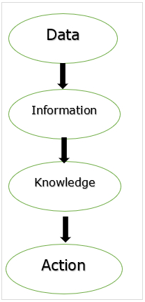
Purpose of Database Systems
DBMS is a collection of programs that enables the user to create and maintain a database.
Data into information.
Information into knowledge.
Knowledge to the action.

Slide 13
Data: Data is raw. It simply exists and has no significance. It can exist in any form. It does not have meaning of itself.
Information: Information is data that has been given meaning by way of relational connection.
Knowledge: Knowledge is the appropriate collection of information, such that it's intent is to be useful. (understanding of the information or subject).

Slide 14
File System Approach
It is also called a traditional based approach in which a decentralized approach was taken where each department stored and controlled its own data with the help of a data processing specialist.
The main role of a data processing specialist was to create the necessary computer file structures, and also manage the data within structures and design some application programs that create reports based on file data.

Slide 15
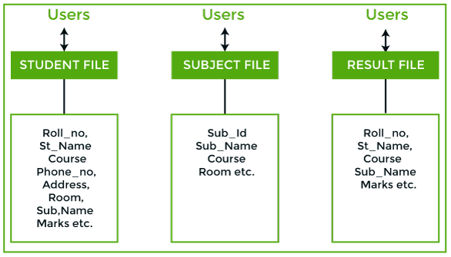
Some fields ( Course, Sub_name, etc.,) are duplicated in more than one file, which leads to data redundancy. So to overcome this problem, we need to create a centralized system, i.e. DBMS approach.

Slide 16
Drawbacks in File System
Data redundancy and inconsistency: Data redundancy occurs when the same piece of data exists in multiple places, whereas data inconsistency is when the same data exists in different formats in multiple tables.
eg: Address
Difficulty in accessing data
Data Isolation: Different files and formats.
data are stored in various files, and files may be in different formats, writing new application programs to retrieve the appropriate data is difficult.
Integrity problems. (the accuracy and consistency of data)
eg: Entering phone no in another field
Atomicity of updates − Failures leave the database in an inconsistent state. For example, the fund transfer from one account to another may be incomplete.
Concurrent access by multiple users.
Security problems.

Slide 17
DBMS
A database approach is a well-organized collection of data that are related in a meaningful way which can be accessed by different users but stored only once in a system.
The various operations performed by the DBMS system are: Insertion, deletion, selection, sorting etc.

Slide 18
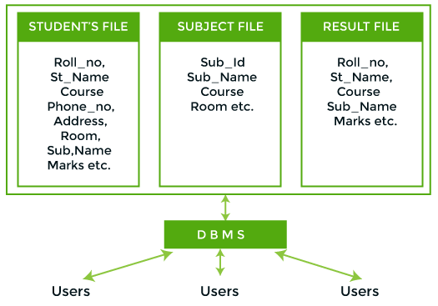

Slide 19
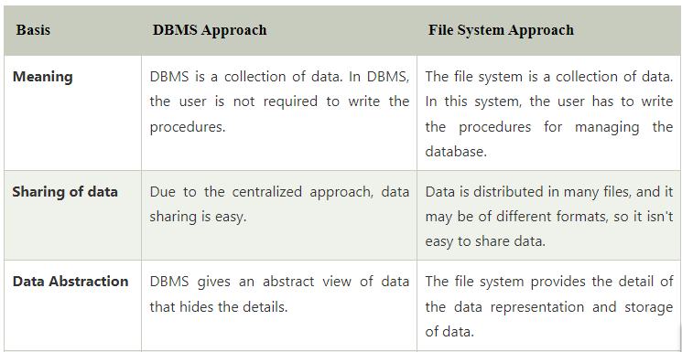
Differences between FMS, DBMS

Slide 20
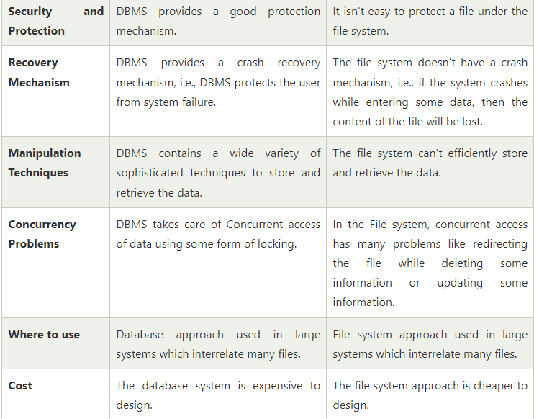

Slide 21
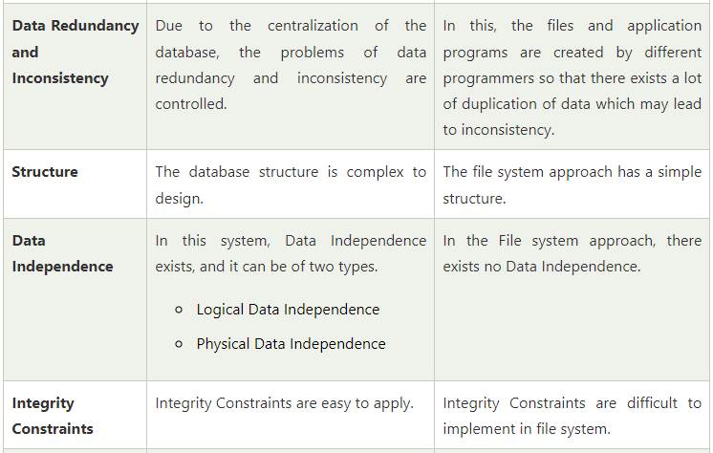

Slide 22
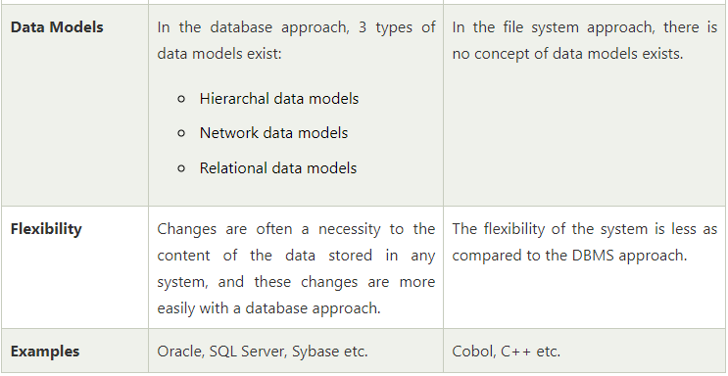

Slide 23
Difference between Schema and Instance in DBMS
Instances : Instances are the collection of information stored at a particular moment.
The instances can be changed by certain CRUD operations as like addition, deletion of data. It may be noted that any search query will not make any kind of changes in the instances.
Example
Let’s say, database is School in which one table is teacher, suppose the table has 50 records.
So the instance of the database has 50 records for now and tomorrow if we will add another fifty records so tomorrow the instance will have total 100 records. This is called an instance.

Slide 24
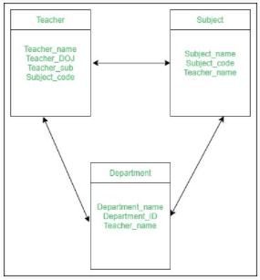
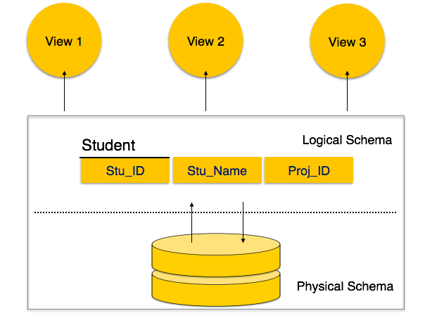
2. Schema : Schema is the overall description of the database. The basic structure of how the data will be stored in the database is called schema.

Slide 25
View of data
A database system is a collection of interrelated data and a set of programs that allow users to access and modify these data.
A major purpose of a database system is to provide users with an abstract view of the data.
That is, the system hides certain details of how the data are stored and maintained.

Slide 26
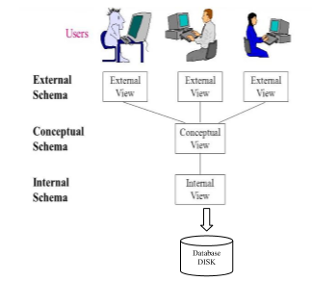
Levels of Abstraction in DBMS

Slide 27
Physical level (or) Internal View / Schema
The lowest level of abstraction describes how the data are actually stored.
The physical level describes complex low-level data structures in detail.

Slide 28
Logical level (or) Conceptual View / Schema
The next-higher level of abstraction describes what data are stored in the database, and what relationships exist among those data.
The logical level thus describes the entire database in terms of a small number of relatively simple structures.
Although implementation of the simple structures at the logical level may involve complex physical-level structures, the user of the logical level does not need to be aware of this complexity. This is referred to as physical data independence.
Database administrators, who must decide what information to keep in the database, use the logical level of abstraction.

Slide 29
View level (or) External View / Schema
The highest level of abstraction describes only part of the entire database.
Even though the logical level uses simpler structures, complexity remains because of the variety of information stored in a large database.
Many users of the database system do not need all this information; instead, they need to access only a part of the database.
The view level of abstraction exists to simplify their interaction with the system.

Slide 30
The main purpose of data abstraction is to achieve data independence in order to save time and cost required when the database is modified or altered.
We have 2 types of Data Independence
1. Physical Data Independence
2. Logical Data Independence

Slide 31
Physical Data Independence: is the data stored in the database. It is in the bit-format. Modification in physical level should not affect the logical level.
For example, If we want to manipulate the data inside any table that should not change the format of the table.
Logical Data Independence: Logical data is the data about the database. It basically defines the structure. Such as tables stored in the database. Modification in logical level should not affect the view level.
For example, If we need to modify the format of any table, that modification should not affect the data inside it.

Slide 32
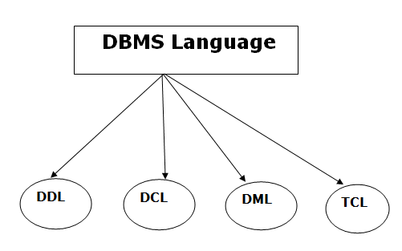
Database Languages
A DBMS has appropriate languages and interfaces to express database queries and updates.
Database languages can be used to read, store and update the data in the database.

Slide 33
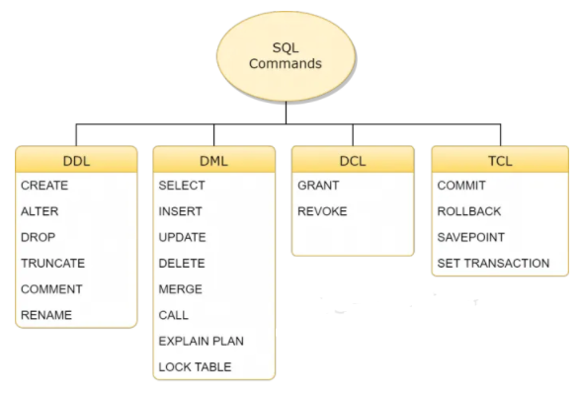

Slide 34
Data Definition Language
DDL stands for Data Definition Language. It is used to define database structure or pattern.
It is used to create schema, tables, indexes, constraints, etc. in the database.
Using the DDL statements, you can create the skeleton of the database.
Data definition language is used to store the information of metadata like the number of tables and schemas, their names, indexes, columns in each table, constraints, etc.
Create: It is used to create objects in the database.
Syntax: CREATE TABLE table_name( column1 datatype, column2 datatype, column3 datatype, ..... columnN datatype, PRIMARY KEY( one or more columns ) );

Slide 35
Alter
Alter: It is used to alter the structure of the database.
ALTER TABLE is used to add, delete/drop or modify columns in the existing table. It is also used to add and drop various constraints on the existing table.
Syntax: ALTER TABLE table_name ADD column_name datatype;

Slide 36
Drop vs Truncate
Drop: It is used to delete a whole database or a table.
Truncate: It is used to remove all records from a table.
Truncate preserves the structure of the table for future use, unlike drop table where the table is deleted with its full structure.
Table or Database deletion using DROP statement cannot be rolled back, so it must be used wisely.
Syntax:
DROP TABLE table_name;
TRUNCATE TABLE table_name;

Slide 37
Rename: It is used to rename an object.
Syntax: ALTER TABLE table_name RENAME TO new_table_name;
Comment: It is used to comment on the data dictionary.
Single line comments: Comments starting and ending in a single line are considered as single line comments. Line starting with ‘–‘ is a comment and will not be executed.
Multi line comments: Comments starting in one line and ending in different line are considered as multi line comments. Line starting with ‘/*’ is considered as starting point of comment and are terminated when ‘*/’ is encountered.
In line comments: In line comments are an extension of multi line comments, comments can be stated in between the statements and are enclosed in between ‘/*’ and ‘*/’.

Slide 38
Data Manipulation Language
DML stands for Data Manipulation Language. It is used for accessing and manipulating data in a database. It handles user requests.
Select: It is used to retrieve data from a database.
Syntax: SELECT column1, column2, columnN FROM table_name;
Insert: It is used to insert data into a table.
Only values: is to specify only the value of data to be inserted without the column names. Syntax: INSERT INTO table_name VALUES (value1, value2, value3,…);
Column names and values both: we will specify both the columns which we want to fill and their corresponding values as shown below. Syntax: INSERT INTO table_name (column1, column2, column3,..) VALUES ( value1, value2, value3,..);

Slide 39
Update: It is used to update existing data within a table.
Syntax: UPDATE table_name SET column1 = value1, column2 = value2...., columnN = valueN WHERE [condition];
Delete: It is used to delete all records from a table.
Syntax: DELETE FROM table_name WHERE [condition];
Merge: It performs UPSERT operation, i.e., insert or update operations.
Lock Table: It controls concurrency.

Slide 40
Data Control Language
DCL stands for Data Control Language. It is used to retrieve the stored or saved data.
The DCL execution is transactional. It also has rollback parameters.
Grant: It is used to give user access privileges to a database.
Syntax: GRANT privileges_names ON object TO user;
Revoke: It is used to take back permissions from the user.
Syntax: REVOKE privileges ON object FROM user;

Slide 41
Transaction Control Language
TCL is used to run the changes made by the DML statement. TCL can be grouped into a logical transaction.
Commit: It is used to save the transaction on the database.
Rollback: It is used to restore the database to original since the last Commit.

Slide 42
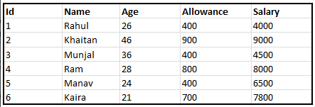
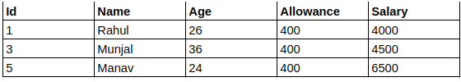
sql> SELECT * FROM Staff WHERE Allowance = 400; sql> COMMIT;

Slide 43
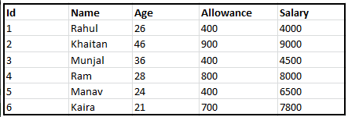
sql> SELECT * FROM EMPLOYEES WHERE ALLOWANCE = 400;
sql> ROLLBACK;

Slide 44
SET TRANSACTION: Places a name on a transaction.
Syntax: SET TRANSACTION [ READ WRITE | READ ONLY ];
SAVEPOINT: A SAVEPOINT is a point in a transaction in which you can roll the transaction back to a certain point without rolling back the entire transaction.
Syntax : SAVEPOINT SAVEPOINT_NAME;

Slide 45
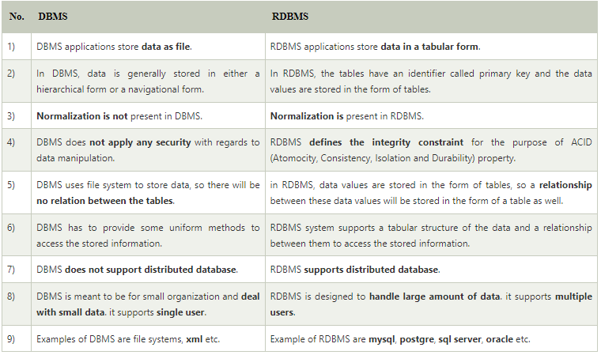
Relational Databases

Slide 46
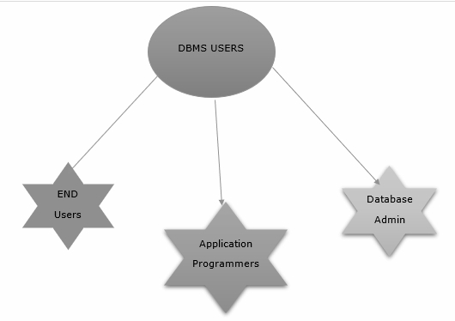
Different types of Database Users

Slide 47
Database Administrator (DBA)
Database Administrator (DBA) is a person/team who defines the schema and also controls the 3 levels of database.
The DBA will then create a new account id and password for the user if he/she need to access the data base.
DBA is also responsible for providing security to the data base and he allows only the authorized users to access/modify the data base.
DBA also monitors the recovery and back up and provide technical support.
The DBA has a DBA account in the DBMS which called a system or superuser account.
DBA repairs damage caused due to hardware and/or software failures.

Slide 48
Application Programmer
Application Programmers are the programmers who writes the code for the application programs or user interface.
They are the computer professionals.
These programs could be written in Programming languages.

Slide 49
End Users
Naive users − The naive users are unsophisticated who don’t have any DBMS knowledge but they frequently use the data base applications in their daily life to get the desired result.
Example: Railway’s ticket booking users are naive users.
Online users − Online users may communicate with databases directly through an online terminal or indirectly through user interface and application programs.
Sophisticated Users − They are those users who interact with the system without writing the program instead they form their request in database query language. They are the SQL programmers, who are going to deal directly with the database. They write queries to delete or select or insert and update the database.
Casual Users / Temporary Users : Casual Users are the users who occasionally use/access the data base but each time when they access the data base they require the new information.
Data Base Designers : Data Base Designers are the users who design the structure of data base which includes tables, indexes, views, constraints, triggers, stored procedures. He/she controls what data must be stored and how the data items to be related.
System Analyst : System Analyst is a user who analyzes the requirements of parametric end users. They check whether all the requirements of end users are satisfied.

Slide 50
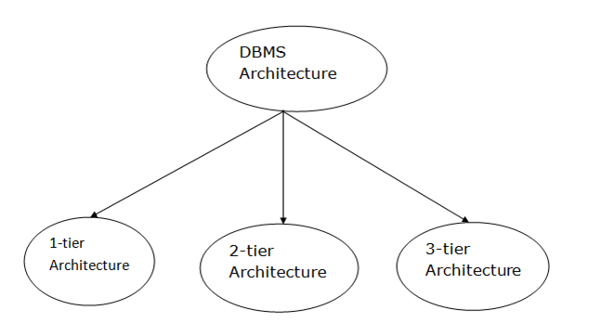
DBMS Architecture

Slide 51
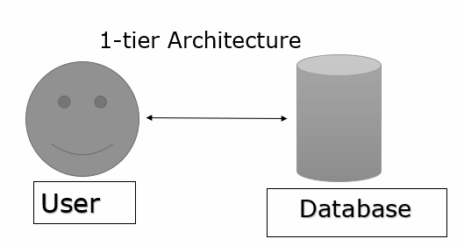
1-Tier Architecture
In this architecture, the database is directly available to the user. It means the user can directly sit on the DBMS and uses it.
Any changes done here will directly be done on the database itself.
The 1-Tier architecture is used for development of the local application, where programmers can directly communicate with the database for the quick response.

Slide 52
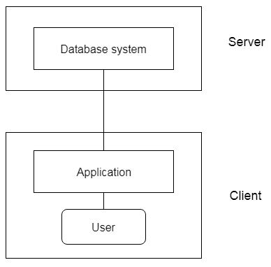
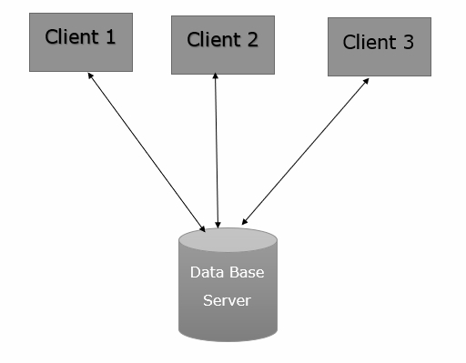
2-Tier Architecture

Slide 53
The 2-Tier architecture is same as basic client-server. In the two-tier architecture, applications on the client end can directly communicate with the database at the server side. For this interaction, API's like: ODBC, JDBC are used.
The user interfaces and application programs are run on the client-side.
The server side is responsible to provide the functionalities like: query processing and transaction management.
To communicate with the DBMS, client-side application establishes a connection with the server side.

Slide 54
3-Tier Architecture
The 3-Tier architecture contains another layer between the client and server. In this architecture, client can't directly communicate with the server.
The application on the client-end interacts with an application server which further communicates with the database system.
End user has no idea about the existence of the database beyond the application server. The database also has no idea about any other user beyond the application.
The 3-Tier architecture is used in case of large web application.

Slide 55
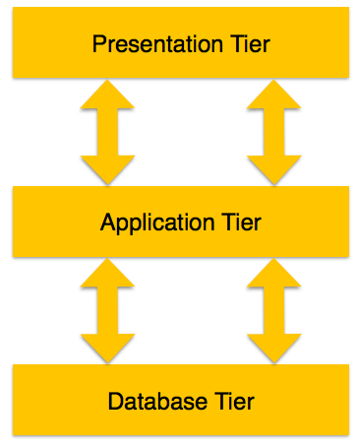
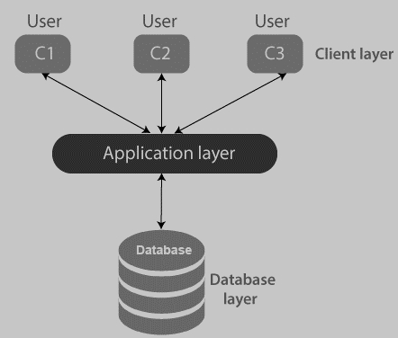

Slide 56
Presentation layer − This layer is also called the client layer. The front-end layer consists of a user interface. The main purpose is to communicate with the application layer.
Application layer − This layer is also called the business logic layer. It acts as a middle layer between the client and the database server which are used to exchange partially processed data.
Database layer − In this layer the data or information is stored. This layer performs operations like insert, update and delete to connect with the database.

Slide 57
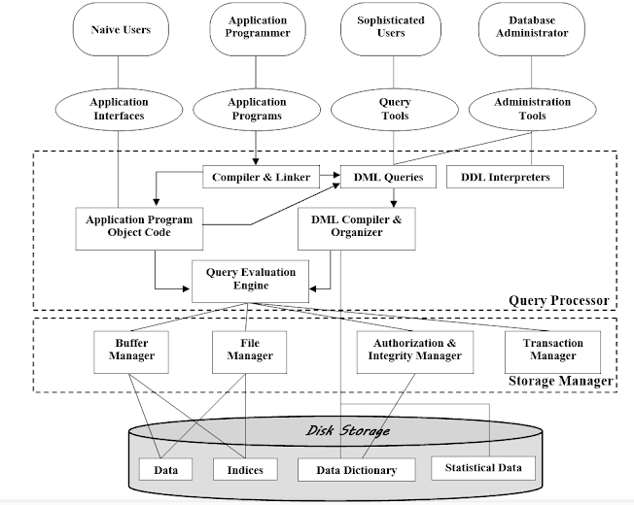
Database System Architecture

Slide 58
The functional components of a database system can be broadly divided into the storage manager and the query processor components.
The storage manager is important because databases typically require a large amount of storage space.
The query processor is important because it helps the database system simplify and facilitate access to data.

Slide 59
Query Processor: It interprets the requests (queries) received from end user via an application program into instructions. It also executes the user request which is received from the DML compiler.
DML Compiler – It processes the DML statements into low level instruction (machine language), so that they can be executed.
DDL Interpreter – It processes the DDL statements into a set of table containing meta data (data about data).
Query Optimizer – It executes the instruction generated by DML Compiler.

Slide 60
Storage Manager : Storage Manager is a program that provides an interface between the data stored in the database and the queries received. It is also known as Database Control System. It maintains the consistency and integrity of the database by applying the constraints and executes the DCL statements. It is responsible for updating, storing, deleting, and retrieving data in the database.
Authorization Manager – It ensures role-based access control. It checks whether the particular person is privileged to perform the requested operation or not.
Integrity Manager – It checks the integrity constraints when the database is modified.
Transaction Manager – It controls concurrent access by performing the operations in a scheduled way that it receives the transaction. Thus, it ensures that the database remains in the consistent state before and after the execution of a transaction.
File Manager – It manages the file space and the data structure used to represent information in the database.
Buffer Manager – It is responsible for cache memory and the transfer of data between the secondary storage and main memory.

Slide 61
Disk Storage :
Data Files – It stores the data.
Data Dictionary – It contains the information about the structure of any database object. It is the repository of information that governs the metadata.
Indices – It provides faster retrieval of data item.

